Slide 1

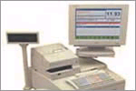

POS “As Is” Process Workshop
May 6, 2003
5965 Coopers Ave., Mississauga

Slide 2
Agenda
Project CASPER Overview (15 min)
Workshop Introduction (15 min)
  Objectives
  Team
  Approach
Refine the high level Sell “As Is” Process (1 hr)
Walk the Process & Record (3-4 hrs)
  Problem Areas
  Rules
  Improvement Ideas
  Measurements
Alan Pinington
Alan Pinington
  “
  “
  “
All
All
  “
  “
  “
  “

Slide 3
Project CASPER Overview

Slide 4
Workshop Objectives
Determine the status of each of the business processes / sub-processes within the project scope so that recommendations can be tailored accordingly.
Identify problem areas.
Identify improvement opportunities.
Identify areas where the current processes / sub-processes are performing well and are candidates to keep in the future design.
Identify whether the processes / sub-processes are critical to the business, industry standard or basic
Identify potential opportunities for process / sub-process harmonization across divisions.
Identify potential opportunities to move responsibility for processes / sub-processes, e.g., to / from customers, suppliers, etc.

Slide 5
Participants
Katz
  Kathy Colvin Nexxsys – Propharm
  Glen Ubelacker Autostar – Propharm
  Kelly Colbran Manager – Katz
  Anna Zahedi Nexxsys – Katz
  Maria Paolino Autostar – Katz
IBM
  Alan Pinnington
  Angelo Cina

Slide 6
Approach

Slide 7
During the workshop we will use a set of ground rules to assist us in focusing our discussion.
Equal vote
Listen to each other
One conversation at a time
Participation vs.. sideline-sitting
Silence means consent
"Brainstorming" vs. "Debating" vs. "Criticizing"
There are no bad ideas!
Work towards a consensus
Full-time participation by everyone
If it isn't written down, it didn't happen
Have some fun !

Slide 8
High Level Front Shop POS “As Is” Process
Sample
Customer
Shop
Pay
Receive
Return
Category Management
Cash
Credit Card
Debit Card
Cheque
Shopping Basket
Airmiles
Katz Stores
Scan Items
(POS)
Dept,Price
(NonPOS)
Receive Payment
Pack Items
Print Receipt
Scan Items
Confirm Receipt
Refund
Exchange Item
DT Stores
AJB
Confirm
Payment
Turbo
Manufacturer
AP
POS
POS
POS
POS
POS
POS
Manual
Automatic
RBS
(EOD)
Rexall
FMS
Microstrategy

Slide 9
High Level Back Shop POS “As Is” Process
Sample
Provide Prescription
Receive
Pay
Return
Customer
Cash
Credit Card
Debit Card
Cheque
Insurance
Category Management
Katz Stores
Lookup / Add Customer
Fill Prescription
Print Receipt
Receive Payment
Scan Items
Confirm Receipt
Refund
Exchange Item
DT Stores
McKesson
Transportation
Manufacturer
Accounts Payable
Manual
POS
POS
POS
POS
POS
POS
Automatic
Microstrategy

Slide 10
Problem Areas
Items not on file
Not in system fast enough (marketing/merchandising information hard copy sent to the stores, ordered, delivered and stocked before merchandise services updates item master in FMS)
Incorrect data (UPC, wrong cost, wrong retail, description) from merchandising services
Stores don’t always receive multiple daily downloads / promo downloads (regular, promo, markup, markdown)
Scanning – some do not have UPCs
No process to validate UPC code
Pharma and Herbie’s don’t have inventory visibility on shelf, backroom, on order at till (mgmt reports in office, query)
Items must be sticker priced for non-POS independents, get them from McKesson pay extra (independents), Rexall uses price guns
Effort to apply and update items
No data, inventory or sales at SKU level for non-pos stores (12-15 Rexall, 450 Independents)
RBS system lingers on
Downtime on AJB system

Slide 11
Rules

Slide 12
Improvement Ideas
Multiple files sent during the day
Vendor standards
Electronic feed from vendor and add price
Standard category manager input, electronic feed, routing
Education, management system drives discipline
Higher standards for vendors
Process for handling merchandise provided free from reps
More discipline pull from Eccnet
Integrate McKesson with Eccnet
Negative/positive confirmation of download receipt
Implement perpetual inventory standard
Install POS for all corporate stores
Offer a cheaper POS system to independents
Capital maintenance for all supply chain systems
Harmonize sales reporting Rexall & Pharma (eliminate RBS)

Slide 13
Measurements

Slide 14
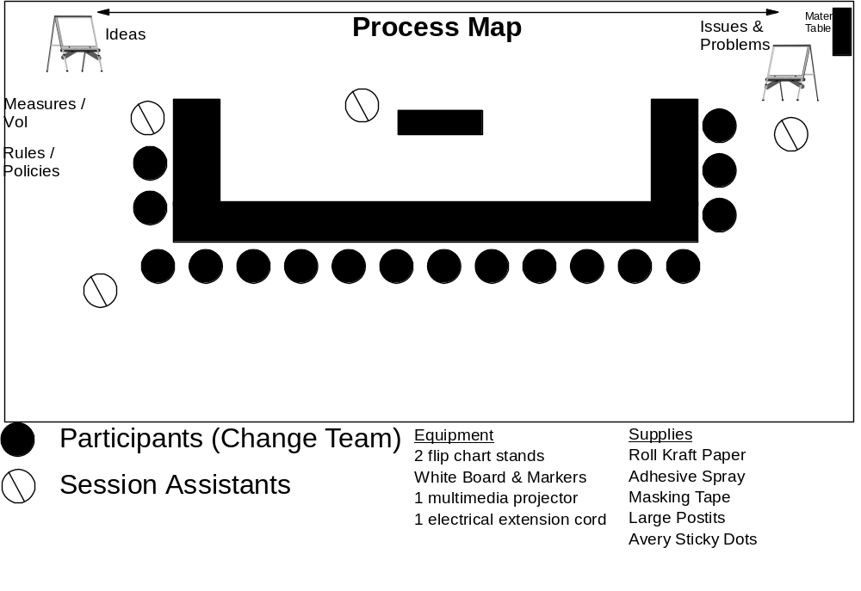
Workshop room with one long clear / clean wall, large enough to allow for catering to be in the room and easy movement

